Slide 1
Christianity: An Intro

Slide 2
Christianity: Origins
Grew naturally out of Judaism in Palestine (Israel)
Jesus is the difference between Judaism and Christianity
Christians believe Jesus is the “Messiah” (The Anointed One / Savior)
Jewish people are still waiting for a Messiah

Slide 3
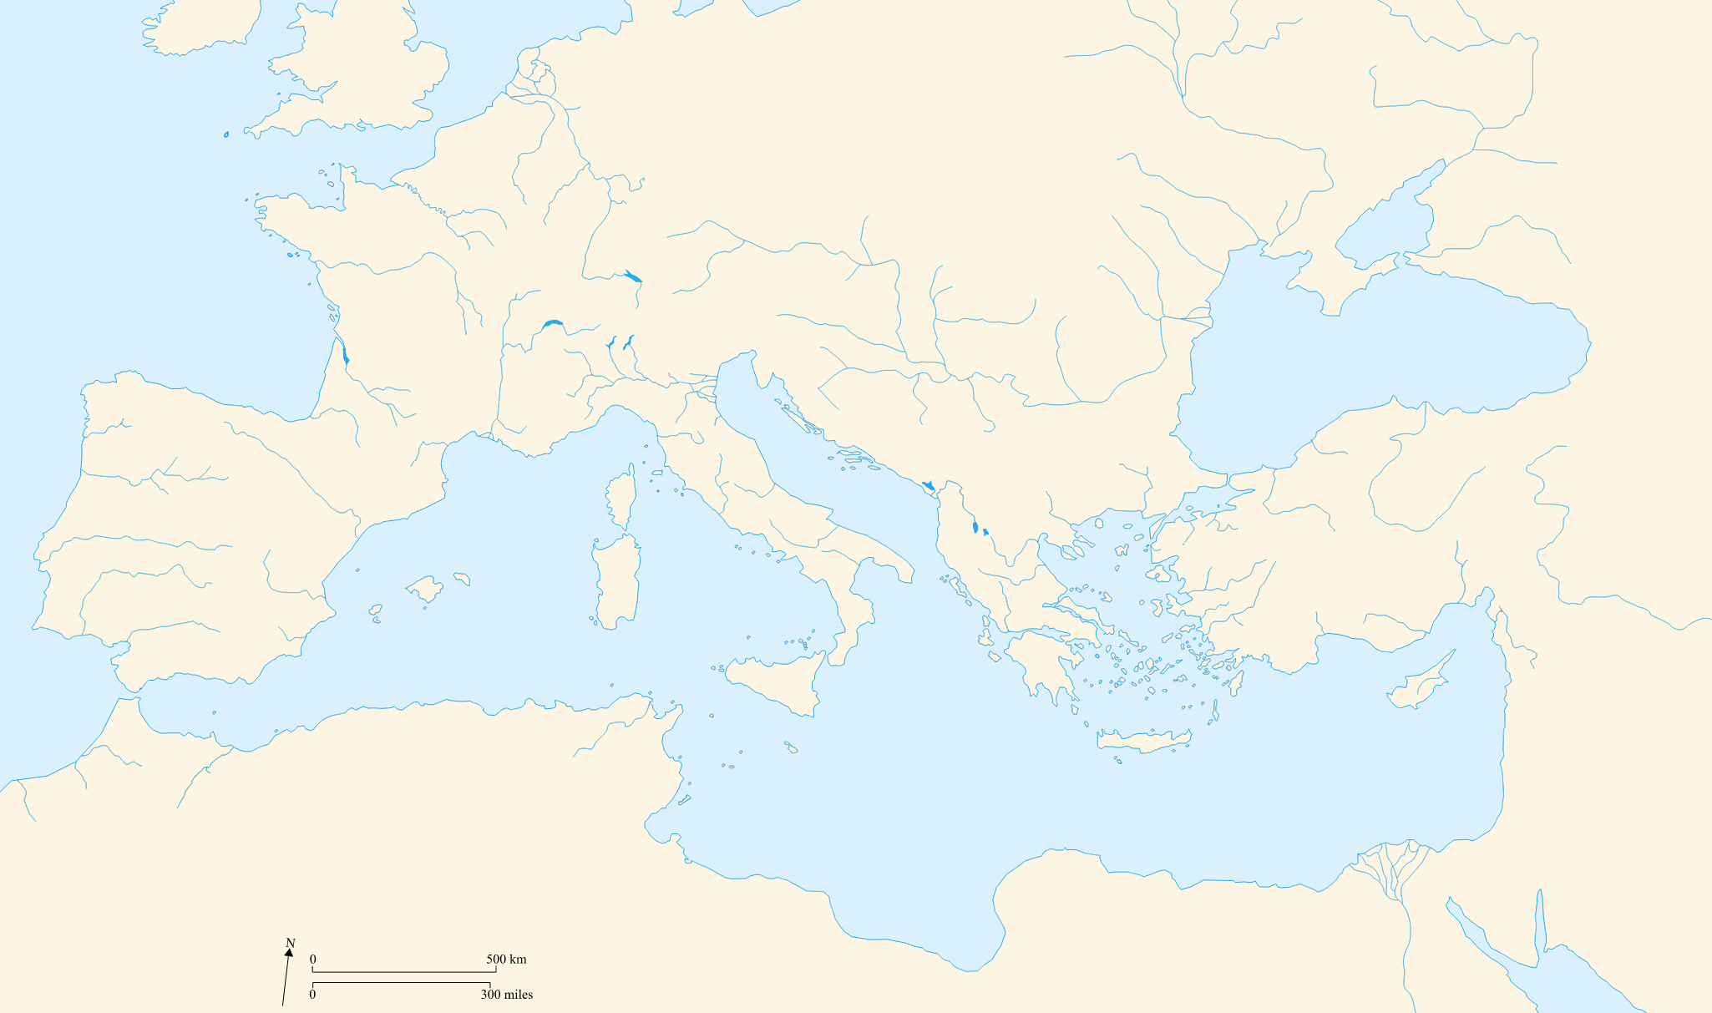

Slide 4
Christianity: Teachings
Jesus of Nazareth was Jewish
Taught people:
Love God
Love each other
Went among the poor, sick, and needy
Gathered followers (“disciples” and “apostles”)
Peter and Paul = 2 most famous apostles

Slide 5
Christianity: Problems
Threat to the Roman Empire
Jesus was executed
Christianity spread anyway

