Slide 1
Beginnings of Rome: The Early Kings

Slide 2
The Legend
As the legend states, Romulus became the 1st king of Rome in 753 BC.
Historians believe Rome could have been founded within 50 years of the date.
Before or After!!

Slide 3
The Beginnings of Rome
The first settlers came to the Italian Peninsula around 1000- 500 B.C
There were three main groups:
Latins
Greeks
Etruscans
Eventually all three groups that lived the region fought for control of the land.
Each group influenced Roman culture differently.

Slide 4
The Latins
Earliest settlers around 1000 B.C.
Settled in Italy in a place called Latium
Farmers and Shepherds

Slide 5
The Greeks
Established in Italy around 750- 600 B.C
Set up colonies southern Italy
Prosperous commercially with trade.
Brought Italy closer to Greek civilization.
Taught to grow new crops like olives and grapes

Slide 6
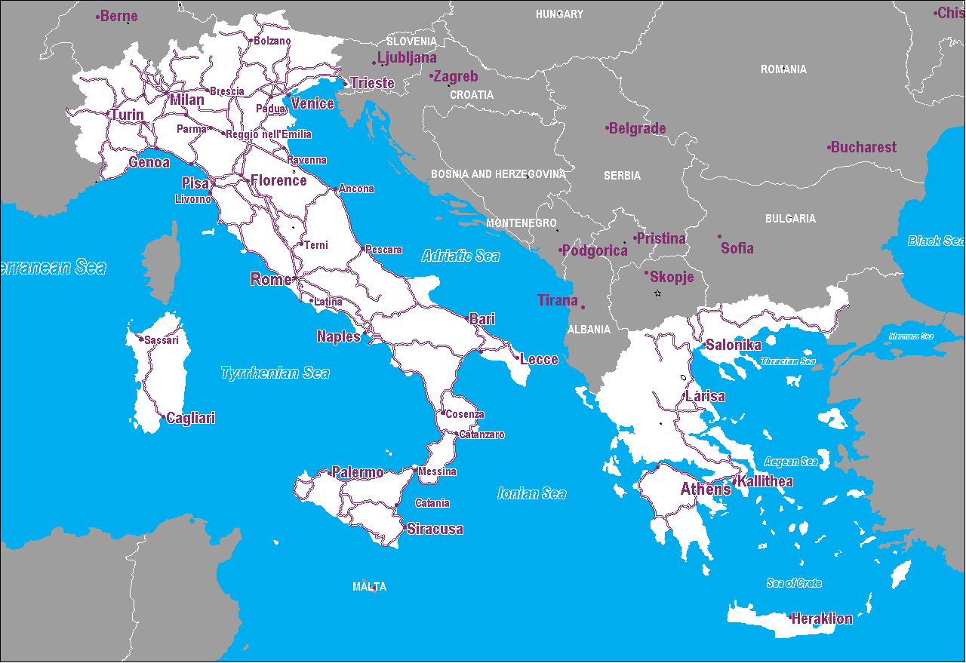

Slide 7
The Etruscans
A mystery where they came from. Thought to be from Asia Minor.
Lived in Northern Italy since 900-800 B.C.
Before Rome was even founded!!
Lived in fortified city-states w/ a strong military

Slide 8
The Etruscan Influence
Had a system of writing and Romans adopted their alphabet.
Skilled metalworkers and engineers
Influenced Rome’s Architecture: The arch
The Gate of Volterra: The 1st known arch in human History

Slide 9
Etruscan Architecture
From the Etruscans the Romans learned how to use the arch, build large aqueducts to transport fresh water, and build the sewers.

Slide 10
Etruscan Metal Working

Slide 11
Etruscan Writing
Most inscriptions found on tombs and monuments and mirrors.
We can pronounce Etruscan words, because they use an alphabet similar to Greek, but we have no clue about their meaning.

Slide 12
Monarchy
Roman records list 7 kings who ruled the city.
They were not all Roman. The last 3 kings were Etruscans.
Rome grew to over 500 square mile under their rule.

Slide 13
The Last King of Rome
Tarquin the Proud
Harsh Tyrant
His rule is characterized by bloodshed and violence.
Loss power in 509 B.C.
Overthrown by aristocrats and landowners
They did not want kings to rule anymore. This was the end of the monarchy

Slide 14
Tarquin [Etruscan] Rulers of Rome
Reign of Romulus 753-716 BCE
Numa Pompilius 715-674 BCE
Tullius Hostillius 673-642 BCE
Anchus Marcius 642-617 BCE
Lucius Tarquinian Priscus 616-579 BCE
Servius Tullius 578-535 BCE
Lucius Tarquinius Superbus 535-509 BCE
509 BCE → Roman Revolt → Republic Established!

Slide 15
The Republic
Latin phrase res publica which means “Public Affairs.”
A Republic is a form of government in which people elect leaders to govern them.
Free-born male citizens vote!

